Slide 1



CAR
May 2019

Slide 2

It’s time for Tea!!!
Need a break?
Have questions about the CAR?
Like tea and cookies?
If yes, come join us for the “CAR Tea time”
May 16, 2019 from 2:00- 3:00 PM
Franklin Room

Slide 3
Have questions about the CAR?
What is the CAR?
Why is it important?
What do I need to know about the CAR?

Slide 4

What is the CAR?
Definition:
Country Alerting Rules are country specific rules for safety document alerting which are entered and maintained in SafetyPortal
The rules describe what safety documents are required for Investigators and Ethics in order to best comply with local law
Decision Maker:
The Country Alerting Rule Responsible is the role accountable for entering this information into SafetyPortal and typically for the decision making.
CAR = Country Alerting Rules

Slide 5
Why is it important?
It is what drives distribution of safety documents to designated recipients (precision distribution)
It is the interpretation of the requirements on how a Sponsor will comply with local law for a country (regulatory intelligence)
It forms the basis of the minimum safety information needed for sites and ethics alike (efficiency)
It helps clients “sleep at night” knowing they have complied with regulations (site and patient centricity)

Slide 6

What do I need to know about the CAR?
Depends on your role at WCG!!!
Integration
Training developers
Helpdesk
Basic Safety terminology
What documents are distributed by the CAR
Options available
Notes:
Cindy

Slide 7





Basic Safety Terminology
Term | Unintended | Drug Related | Serious | Unexpected
Adverse Event | ✓ |  |  | 
Adverse Drug Reaction | ✓ | ✓ |  | 
Serious Adverse Event | ✓ |  | ✓ | 
SUSAR/INSDR | ✓ | ✓ | ✓ | ✓
CRF
Not all SAEs are SUSARs!
Reporting of SAEs and SUSARs are time bound
Tea time note!
Notes:
Christina

Slide 8
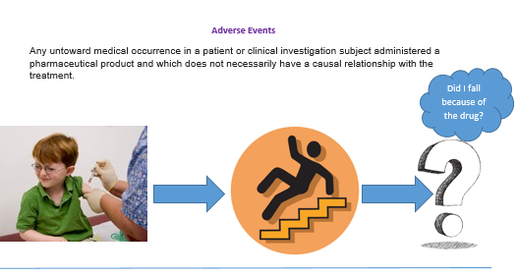
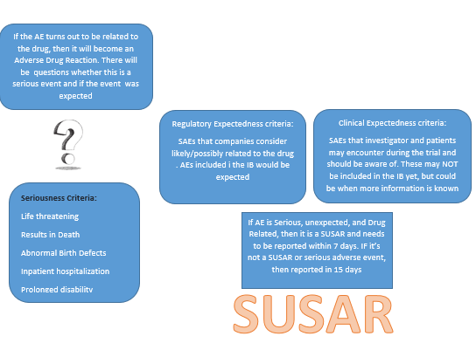
For example….

Slide 9

Documents distributed by the CAR
SUSARs
Domestic/Protocol
Reports
Reference
IB
SUSAR Line listing
Causality
Sponsor/Non-Sponsor
7/15
Yes or no!
Yes or yes!
The global alerting options form the basis of the CAR for a country
Tea time note!
Ethics and Investigators do not always have the same requirements
Tea time note!
Blinded /open label and Unblinded documents may be available
Tea time note!

Slide 10
Tea time challenge
Team 1 – The Earl Grey!’s
6 Tea Time Questions
The team that gives the best answer, is the tea time champion!!!
Earl Grey
Team 2 – The Orange Pekoe's
Orange Pekeo
Team 3 - I want coffee
I want coffee

Slide 11

Question 1
What does SUSAR stand for?
Suspected unreported serious adverse reaction
Suspicious unrelated serious adverse reaction
Suspected unexpected serious adverse reaction
Suspicious unexpected serious adverse reaction
SUSAR
Report

Slide 12

Question 1
What does SUSAR stand for?
Suspected unreported serious adverse reaction
Suspicious unrelated serious adverse reaction
Suspected unexpected serious adverse reaction
Suspicious unexpected serious adverse reaction
SUSAR
Report

Slide 13


Question 2
How do 7 and 15 day SUSAR reports differ?
The 7 day report is a “heads up” that the event resulted in a death or was life threatening, while the 15 day is the full report
A 15 day report is a SUSAR where the event resulted in a death or was life threatening
A 15 day SUSAR is a protocol specific event
7 and 15 day SUSARs report on different events that occurred for a patient

Slide 14

Question 2
How do 7 and 15 day SUSAR reports differ?
The 7 day report is a “heads up” that the event resulted in a death or was life threatening, while the 15 day is the full report
A 15 day report is a SUSAR where the event resulted in a death or was life threatening
A 15 day SUSAR is a protocol specific event
7 and 15 day SUSARs report on different events that occurred for a patient

Slide 15
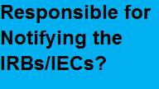
Question 3
Why does the CAR ask who reports to the ethics?
Because the CAR is nosey!
Because all Regulatory Agencies specify who is accountable to report to ethics
To provide the Investigator with any additional safety documents needed, if required to report to ethics
So that the Investigator can receive unblinded documents, if required for the ethics for their site

Slide 16

Question 3
Why does the CAR ask who reports to the ethics?
Because the CAR is nosey!
Because all Regulatory Agencies specify who is accountable to report to ethics
To provide the Investigator with any additional safety documents needed, if required to report to ethics
So that the Investigator can receive unblinded documents, if required for the ethics for their site

Slide 17

Question 4
Which of the following is false?
The blinding status of a study determines if unblinded documents are needed for a country!
Unblinded and open label SUSARs reveal the treatment a patient received
The CAR indicates if unblinded documents are needed by the ethics for a country
Unblinding of Sponsor, Site and Ethics should be kept to a minimum to preserve the integrity of the blind of the clinical trial
Unblinded SUSARs and SSRs required for IRB/IECs?

Slide 18

Question 4
Which of the following is false?
The blinding status of a study determines if unblinded documents are needed for a country!
Unblinded and open label SUSARs reveal the treatment a patient received
The CAR indicates if unblinded documents are needed by the ethics for a country
Unblinding of Sponsor, Site and Ethics should be kept to a minimum to preserve the integrity of the blind of the clinical trial
Country!!!!

Slide 19

Question 5
What elements make a SAE Report valid?
Investigator name, causality, suspect drug and adverse event
Investigator name, adverse event, suspect drug, identifiable patient, and causality
Investigator name, adverse event, suspect drug, and identifiable patient
Investigator name, adverse event, identifiable patient, and causality
Are you an SAE?

Slide 20

Question 5
What elements make a SAE Report valid?
Investigator name, causality, suspect drug and adverse event
Investigator name, adverse event, suspect drug, identifiable patient, and causality
Investigator name, adverse event, suspect drug, and identifiable patient
Investigator name, adverse event, identifiable patient, and causality
Are you an SAE?

Slide 21
Question 6
How does WCG ensure the integrity of the CAR used in SafetyPortal?
Developing a standard process for overseeing the CAR
Conducting periodic review of the CAR
Version control of the CAR
Management of the handoff of the CAR

Slide 22

Tie Breaker question
What does MCN mean?
Manufacturer’s Control Number
Master Customer Number
Management Control Number
Mobile Communications Unit
MCN

Slide 23


Slide 24
Back up slides

Slide 25
CAR Questions
CAR Alerting Options
SUSAR options | All SUSARs
 | Protocol Only (only events from a specific protocol)
 | Domestic Only (only events from a specific country)
 | Protocol and Domestic
Causality Assessment Criteria for SUSAR alerts | Sponsor Causality
 | Investigator Causality Both
7-Day SUSAR notification required | Yes
 | No
Non-Sponsor comparator SUSARs required | Yes
 | No
IB | Yes
SSR | Yes
 | No
Unblinded Safety Documents* (as per selection for SUSARs and SSR) | Yes
 | No
DSUR* | Yes
 | No
Who is accountable for providing safety documents to the ethics?
Sponsor/Investigator/Either
Background: If different requirements, Investigator will need documents for the IRB in addition to the documents they will receive
Do you need SUSARs?
Yes
Questions to confirm subset
7 Day
Non Sponsor
No
SSR becomes the default
Reduced Reporting?
Yes/No
Background: Question posed top confirm if there was a business case to include as a country specific rule. Never implemented as it would be “fraught” with errors
Investigator and IRB
IRB Only
Same rules for Investigators and ethics?
Yes/No
Background: Simplicity to default appropriate answer options

Slide 26

Quality Oversight of the CAR
CAR Oversight SOP in development
The purpose of the SOP is to describe the process for managing the “factory settings” of the Country Alerting Rules defined and used in SafetyPortal. This procedure is inclusive of the following processes:
Confirming the document and country characteristics used in the CAR so that they will continue to meet regulatory expectations for safety reporting to Investigator’s and Ethics committees.
Updating the “Factory settings” for new and existing clients of SafetyPortal
Communicating updates and changes to SafetyPortal Clients and internal WCG stakeholders
This procedure occurs on a minimum of an annual basis and outcomes are published internally within WCG.
Annual Review in progress – lesson learned
Need to version control the CAR used in SafetyPortal
Where is CAR referenced
IDL, xx,xx
Need to maintain the inventory of the CARs used
Develop a controlled list of version used in SafetyPortal
Formal request and handoff of CAR export
More to come!!!

Slide 27
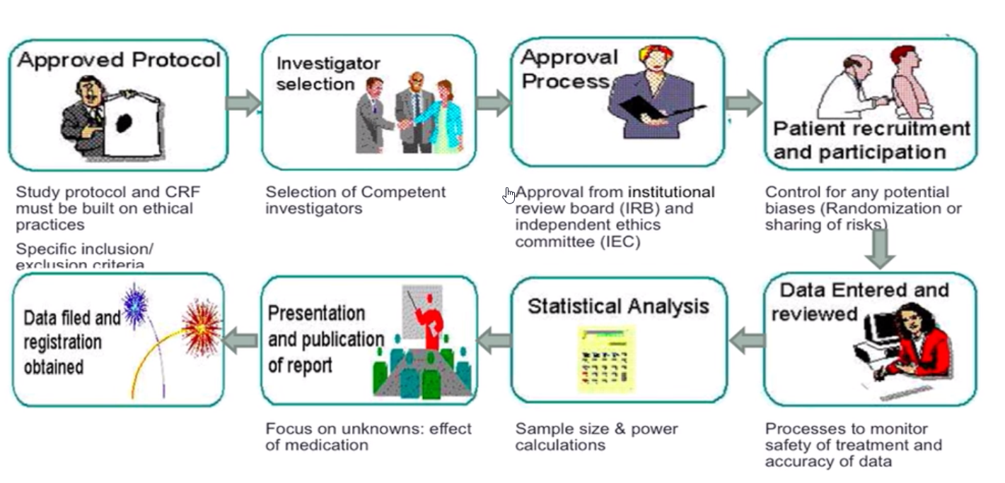
Safety In the Clinical Trial Process
Safety Management is a process that starts prior to a clinical trial commencing and continues throughout its lifecycle and beyond
.
Notes:
Suggest removing text and referencing safety aspects at each step
Approved protocol
Safety Reporting Processes
Exceptions to SAE definitions
Investigator Selection
GCP training
Investigator Responsibilities
SAE reporting training
Approval Process
Ethics Review
IRB Requirements
Safety Documents
IB/RSI
Patient Recruitment and Participation
Informed Consent
Risk and benefits
Training
Data Filed and Registered
Health authorities
Ethics
Ongoing PV activities marketed products
Presentation and Publication if Report
Aggregate reporting
Annual reporting
IB/LPIs
DSURs
CSR
Statistical Analysis
Trends
Patient populations
Data Entered and Reviewed
AE - CRF
SAE – within 24 hrs

Slide 28


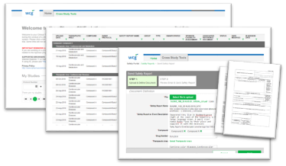

End to End Safety Management An Overview
Sponsor
Data Collection
Safety Reporting
SAE
Accountabilities
Medical Review
Analysis and trends
Risk benefit profile
Reference Safety Information
Safety Database
Spontaneous reports
Monitoring and literature searches
…..
SPEED
Considerations
Regulatory Requirements
GCP
Clinical Trial protocols
Data Collection Processes
Data Collection Systems
Timelines
AEs vs SAEs
Training
Investigator Responsibilities
Considerations
Regulatory Requirements
Document Formats and standards
Aggregate vs Individual case reporting
Marketing status
Annual Updates
Expedited vs Non-Expedited

Slide 29

Serious Adverse Events (or Serious ADR)
SAE definition is a global standard
Any untoward medical occurrence that at any dose:
results in death
is life-threatening
requires inpatient hospitalization or prolongation of existing hospitalization
results in persistent or significant disability/incapacity
is a congenital anomaly/birth defect
Investigator must report within 24 hours of awareness
Sponsor reporting clock starts when an SAE is received with the 4 valid elements:
Identifiable patient
Drug
Event
Reporter
Note: Causality not considered a valid element but must be provided for proper assessment of case
See ICG GCP (E6)
https://www.ich.org/fileadmin/Public_Web_Site/ICH_Products/Guidelines/Efficacy/E6/E6_R2__Step_4_2016_1109.pdf

Slide 30

SUSAR
Suspected Unexpected Serious Adverse Reactions (SUSAR)
All adverse drug reactions (ADRs) that are both serious and unexpected are subject to expedited reporting
Suspected – referring to the causality
Drug related
Unexpected – referring to the RSI (IB/SmPC)
Not previously known
Reporting Timelines:
7 Day -Fatal or Life-Threatening
Regulatory agencies should be notified (e.g., by telephone, facsimile transmission, or in writing) as soon as possible but no later than 7 calendar days after first knowledge by the sponsor that a case qualifies, followed by as complete a report as possible within 8 additional calendar days.
15 Day – All other
Reporting forms:
CIOMS – Non-US
Medwatch – US
Note: US sites and IRBs accept CIOMS as an internationally recognized reporting form

Slide 31

Other documents used for reporting
SSR – Six monthly SUSAR Report
Aggregate report containing line listings for all studies using in the compound. Typically contains a overall sponsor assessment of risk
Frequency of aggregation not standard
SSR = SUSAR Summary Report
Frequency is determined by the Sponsor
DSUR – Development Safety Update Report
Globally recognized document, described in ICH (E2F) and EU regulations. Target audience is regulators and Ethics but often multipurpose (i.e. Annual reporting). Consider this a unblinded document
A sponsor can substitute Executive summary and line listings in lieu of a DSUR, if accepted by the IRB/IEC
https://www.ich.org/products/guidelines/efficacy/efficacy-single/article/development-safety-update-report.html

Slide 32
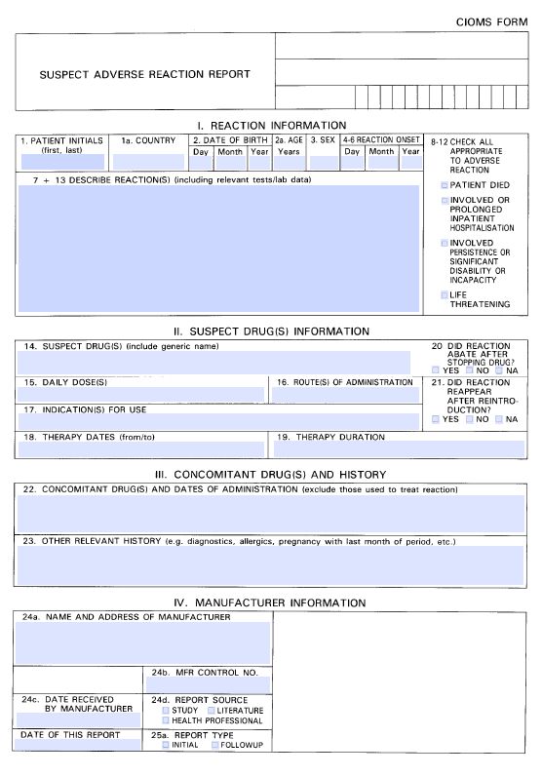
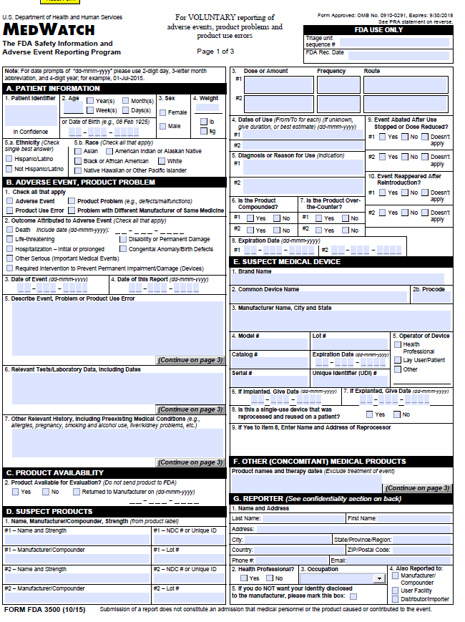
Forms
SUSAR
Typically consists of a
Cover letter
CIOMs
Analysis of similar events
7 day – just the CIOMS
https://cioms.ch/wp-content/uploads/2017/05/cioms-form1.pdf
https://www.fda.gov/downloads/aboutfda/reportsmanualsforms/forms/ucm163919.pdf

